Slide 1

8051 ALU
UVM Verification
By:
Almomenbelah Allam: V23009973
Mahmoud Mansour: V23010559

Slide 2


CONTENTS
Introduction
UVM verification
Test design
Results

Slide 3

Introduction

Slide 4
The 8051 microcontroller
Designed by intel in the 1980’s and received huge popularity
Included several features such as ROM,RAM, and multiple timers.
Our project aims to perform UVM verification of the ALU module of the microcontroller.
The RTL we used was adapted from OpenCores.org and was made by Jaka Simsic and Simon Teran

Slide 5
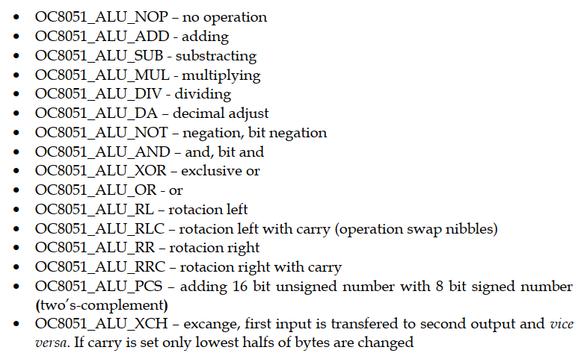
8051 ALU
The ALU is responsible for performing up to 16 types of arithmetic operations that are needed by the CPU.
The different types of operations are shown in the figure on the right.
All operations are combinational and take zero time except for the multiplication and division operations which take multiple cycles.

Slide 6
UVM verification

Slide 7

UVM
UVM (universal verification methodology) is a is a standardized methodology for verifying integrated circuit designs.
It was developed in 2009 by several EDA companies.
It aims at increasing the reusability of the created testbenches to be used in future projects.

Slide 8
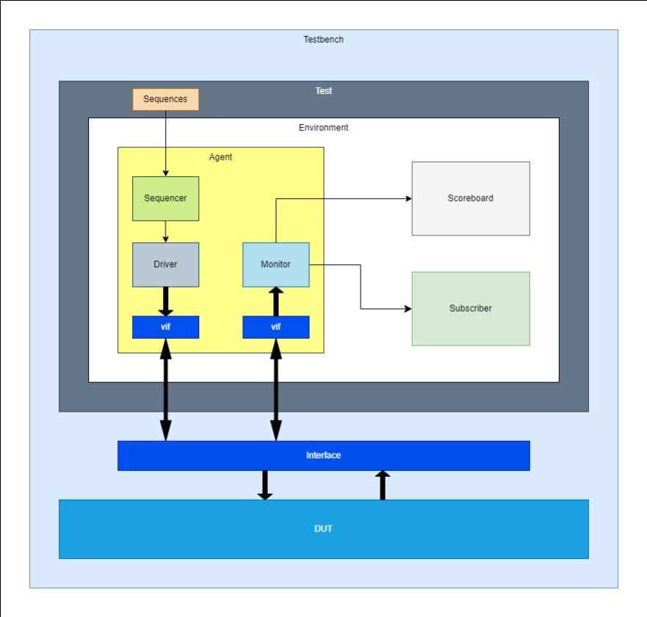
Testbench
Our testbench will follow standard UVM architecture.
It will contain one agent that will contain a Sequencer for managing the incoming sequence, a Driver for driving the interface, and monitor to sample the interface.
The monitor sends its data to the scoreboard for error checking and to the subscriber for coverage collection.

Slide 9
Goals
To ensure that the module operation and functionalities are mostly covered, The
following goals were set forward for the simulation:
100% code coverage of all lines in the RTL.
100% toggle coverage of all signals in the interface.
100% coverage of the created covergroups.

Slide 10
Test design

Slide 11
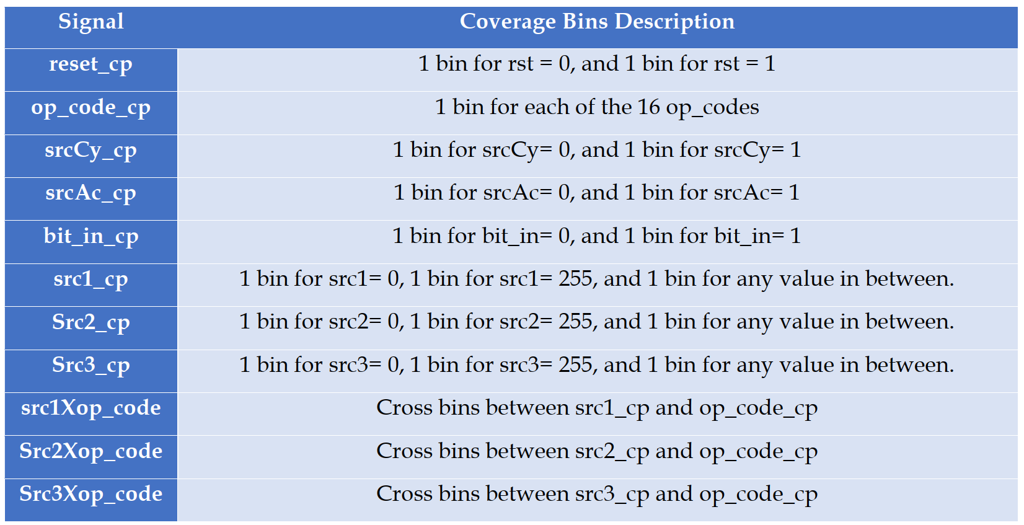
coverpoints
The table on the right shows the coverage points created for coverage collection.
The bins created for the src1, src2, and src3 inputs prioritize their minimum and maximum values of 0 and 255 respectively. This is because these extreme values are more likely to cause unexpected errors in the ALU.

Slide 12
Sequences
The DUT was subjected to 483 operations, consisting of 3 sets of a reset operation followed by 160 random operations.
The Op_code input to the DUT changes every 10 operations.
The first 160 operations (which cover all 16 operation types) have randomized src1, src2, and src3 inputs.
The next 160 operations have the source inputs set to 0.
The final 160operations have the source input set to 255.
This way, we can ensure that we test the operations of the ALU at all extreme values.
The src inputs remain unchanged during multiplication and division operations as they take up multiple clock cycles

Slide 13
Results

Slide 14
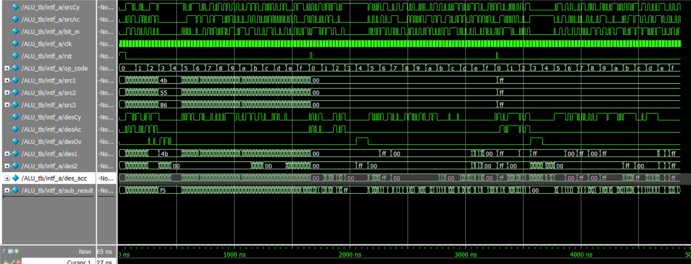
Results
The figure below shows the waveforms of the created test.
The scoreboard found that the output from the DUT matched that of the reference model at every clock cycle

Slide 15
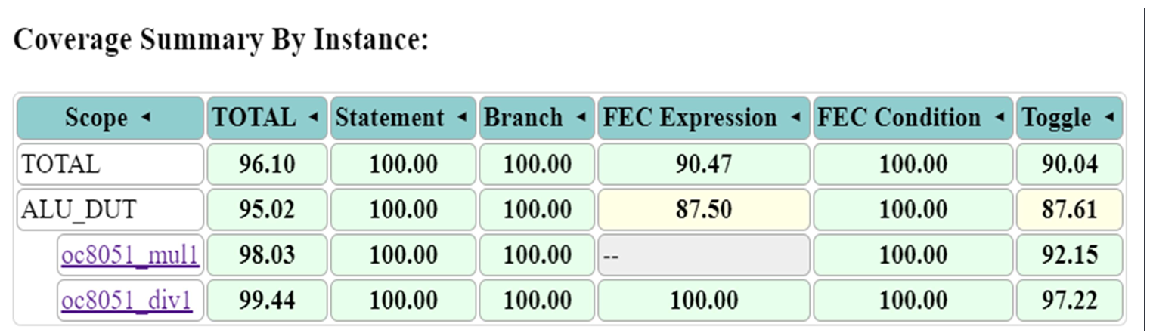
Code Coverage
The figure below shows the code coverage report for the ALU_DUT.
It can be seen that all lines in the RTL have been successfully covered.
This confirms that the logical parts of the ALU have been fully covered.

Slide 16
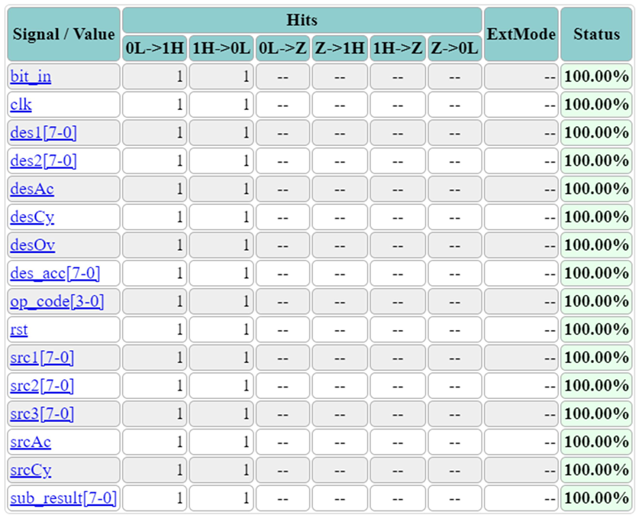
Toggle Coverage
The figure on the right shows the toggle coverage report for the interface.
It can be seen that bits in the interface have been successfully toggled on and off.
This is useful in post-fabrication testing to check if any fabrication errors caused some the chip pins to be stuck at a specific value.

Slide 17
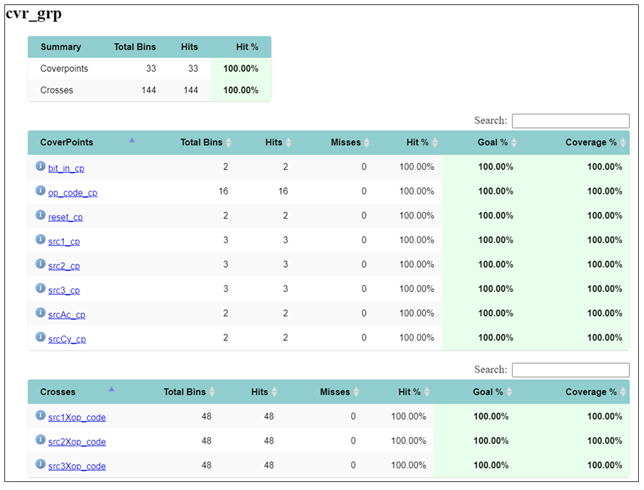
Coverpoints Coverage
The figure on the right shows the coverage report for out created coverpoints.
It can be seen that all the created coverpoints have been fully covered, Even the very large cross bins between the op_code and the source inputs.
This adds great confidence that the ALU functions correctly.

Slide 18
Thank You!

